Slide 1




Support to Armenia-Turkey Rapprochement:
Peace Youth Bank Project builds bridges between young people in
Armenia and Turkey
October 22-23, 2012 Istanbul

Slide 2
What is the Youth Bank
YB is a place for young people where they can …
Borrow resources and return to their communities and friends;
Resources in form of:
  money,
  skills,
  action and change;
The ‘interest’ is charged to young people in form of progress in their own lives and attitudes;
It’s a place for young people to become responsible, confident, fair, creative, capable of solving problems and make a change with their actions …
And much more…

Slide 3
Youth Bank and Cross-border work
EPF and TOG introduced the Youth Bank approach as a platform to meet a wider range of strategic goals:
The Peace Youth Bank project helps to understand how prejudices and stereotypes can color and shape what we see and hear before coming together;
The personal experiences teach to think based on facts and realities rather than assumptions and fears;
Makes space for different perspectives and points of view in a group with diverse political and cultural backgrounds.
Youth are taught to make their own judgment and not be part of those of others

Slide 4
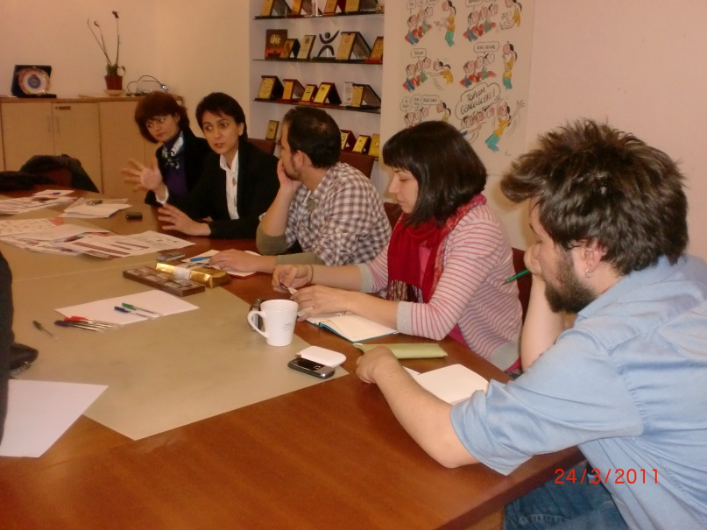
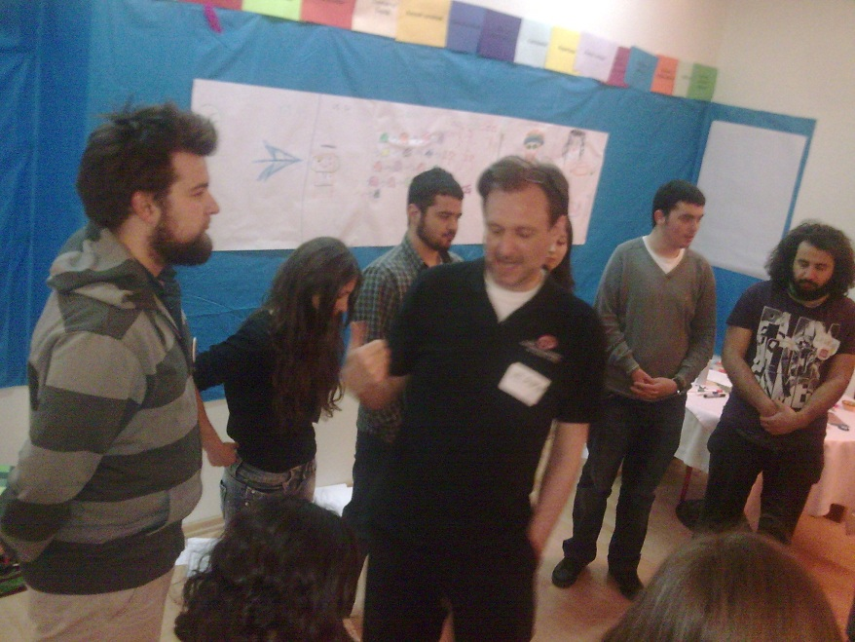
Pre-history and today
10 YBs operating in Armenia and 6 in Turkey
2 exchange visits took place
15 youth from Turkey visited Armenia
19 youth from from Armenia visited Turkey
165 Armenian and Turkish youth met and shared impressions, experiences
5 Jointly implemented projects in Armavir, Yeghegnadzor , Samsun town square (Peace flowers), Nor Geghi school, Vanadzor boarding school.
40 youth from Turkey and Armenia sharing on FB

Slide 5
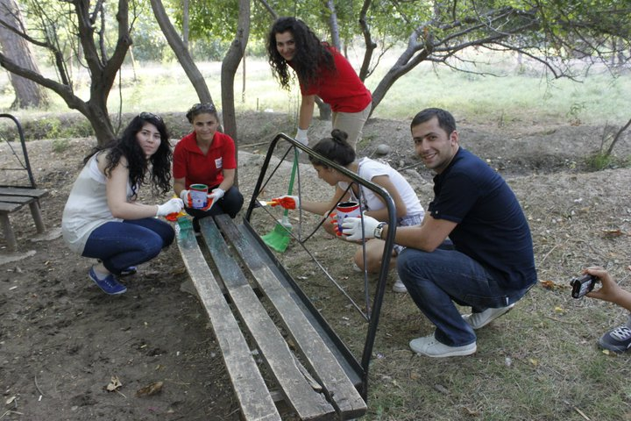
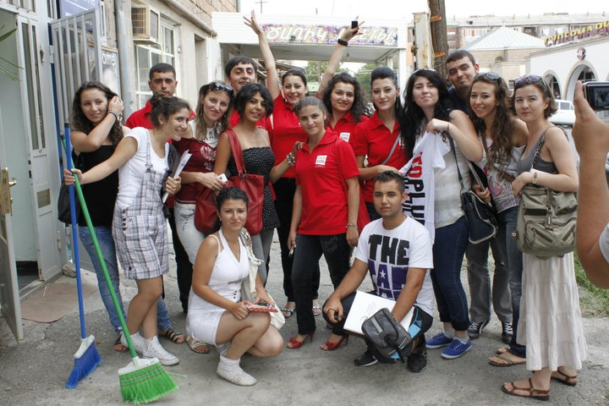

Slide 6
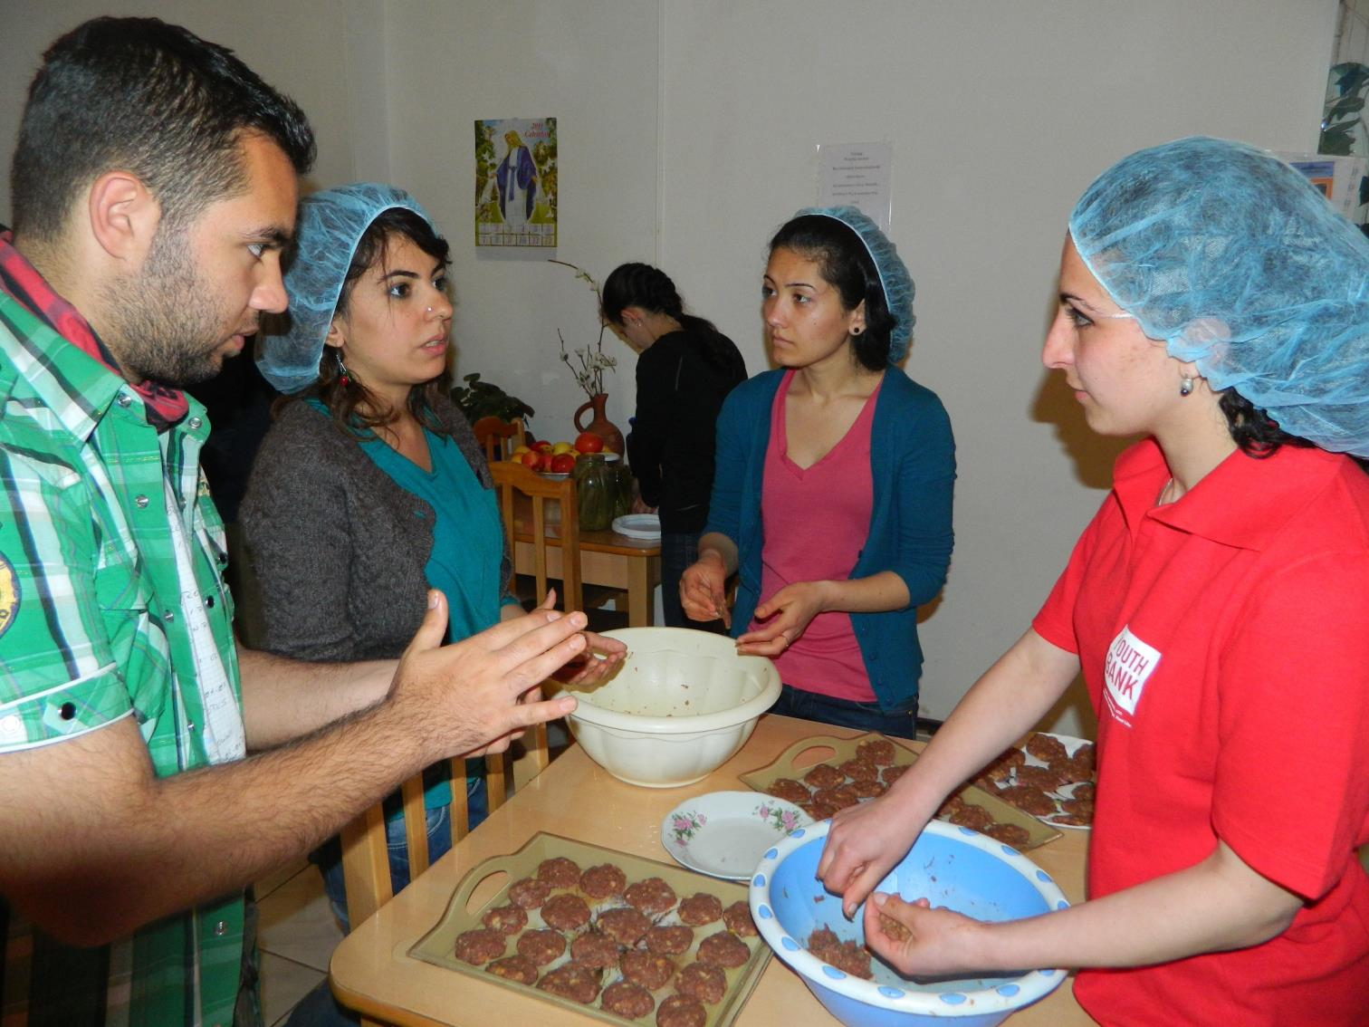
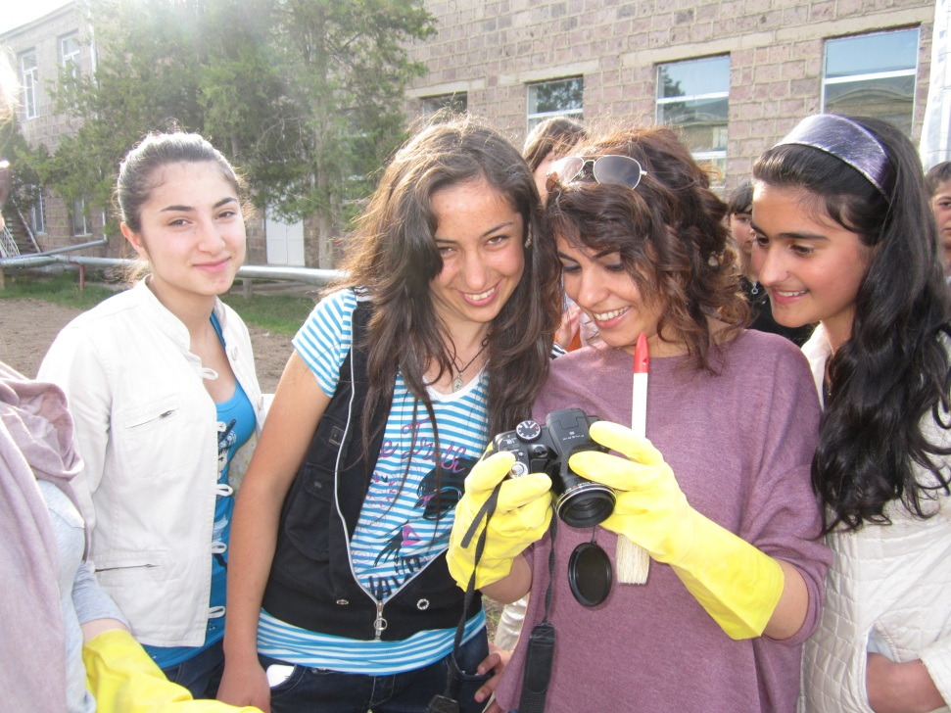
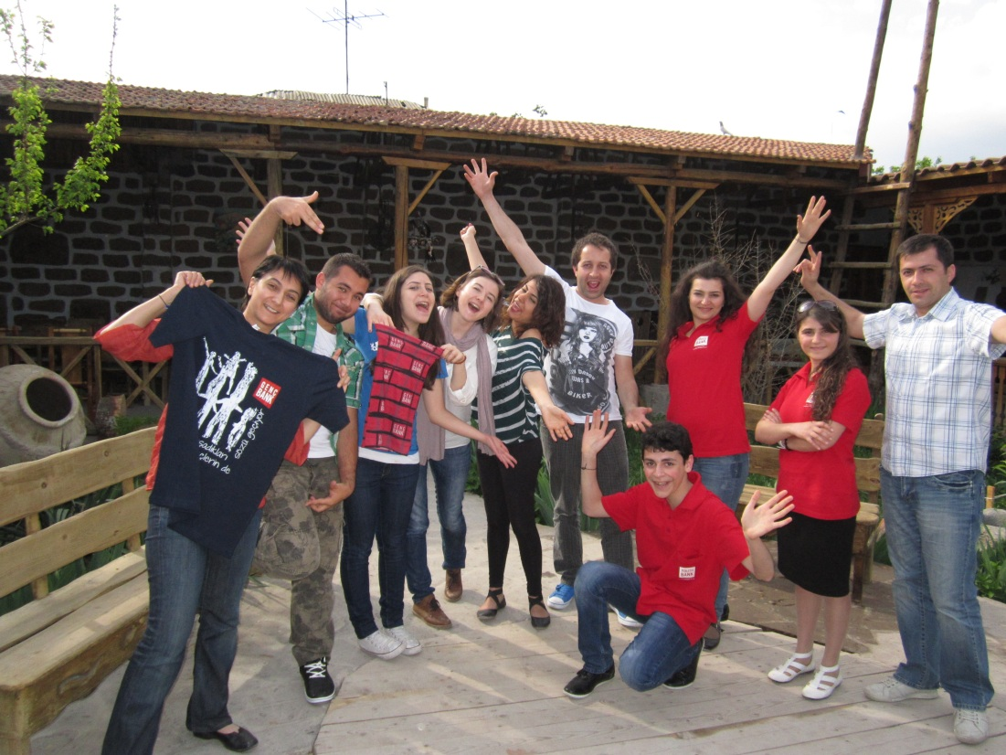

Slide 7
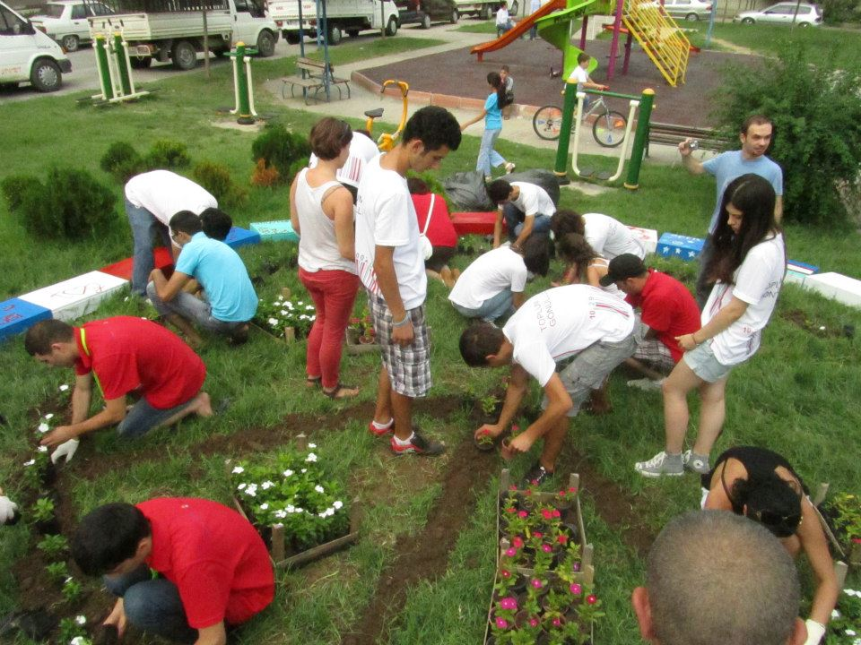
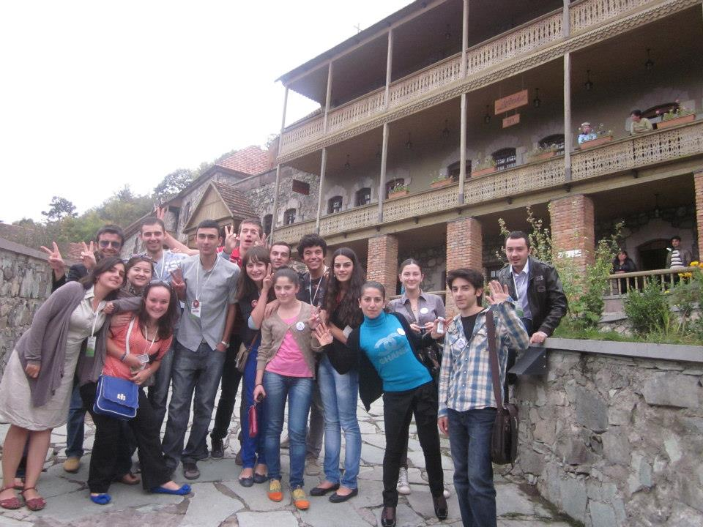
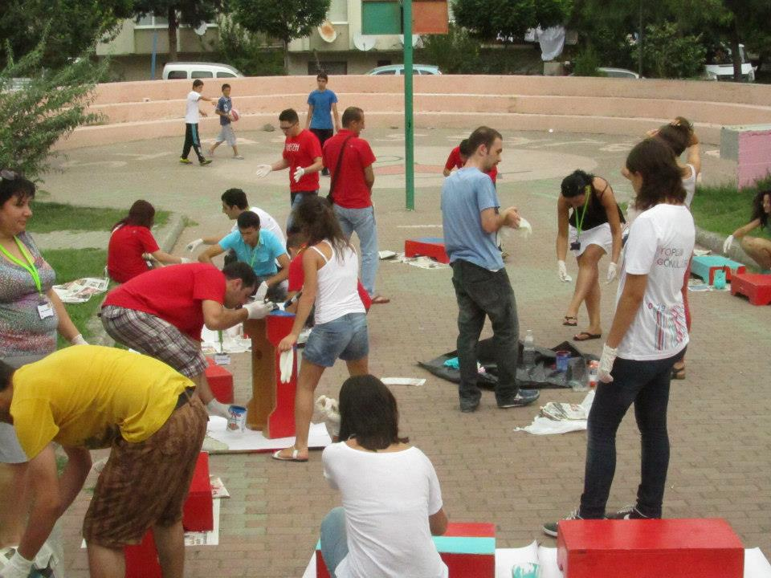

Slide 8
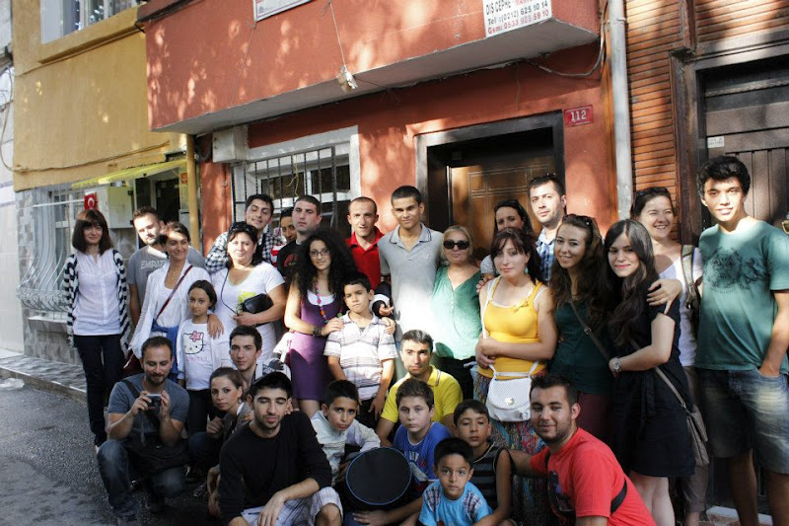
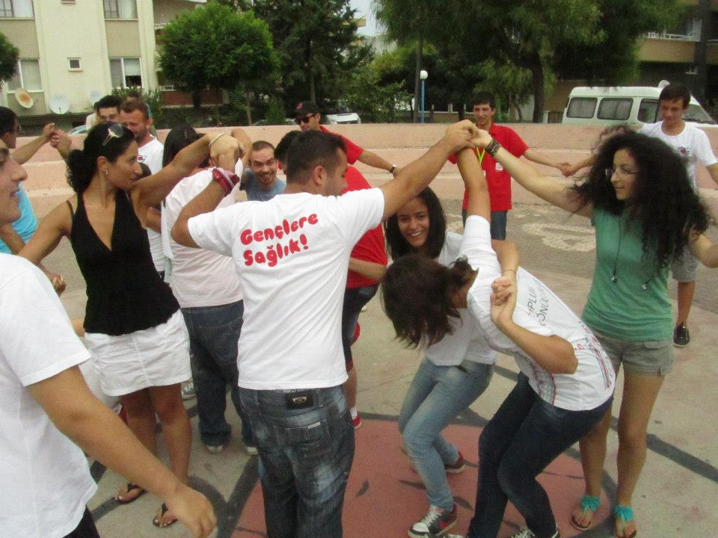
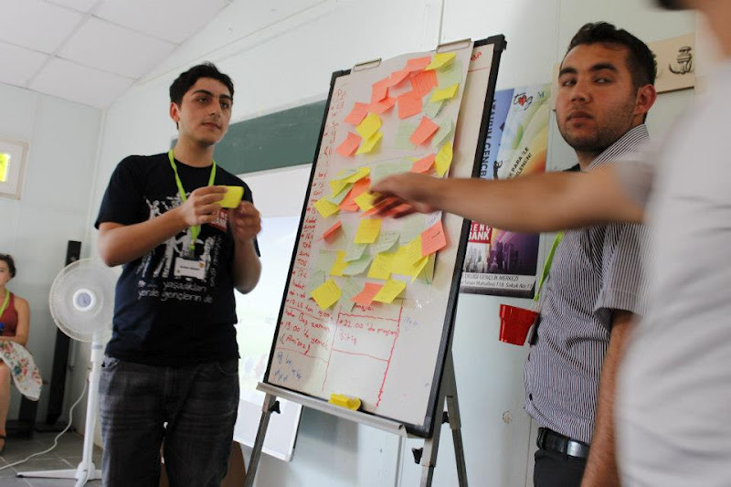

Slide 9
Change Paradigm
Conflict transformation is a long-term process and
implies a deep transformation in the societies
change in their relationship towards one another and
towards the conflict itself
EPF’s and TOG’s efforts are called to positively transform the relationship between the Turkish and Armenian through bridging together young people

Slide 10
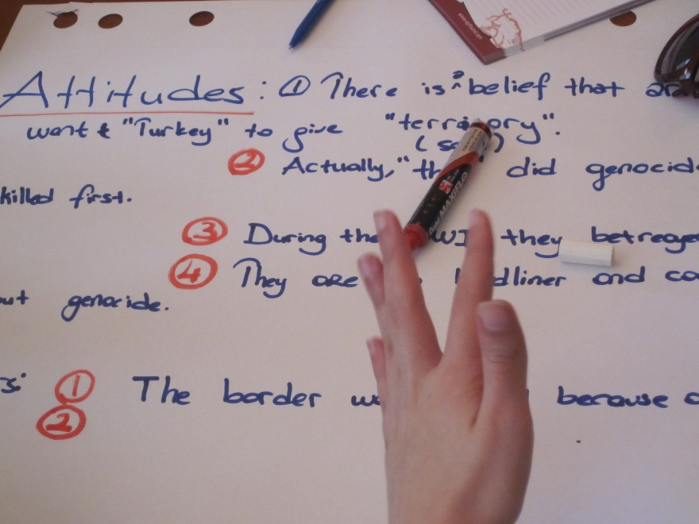
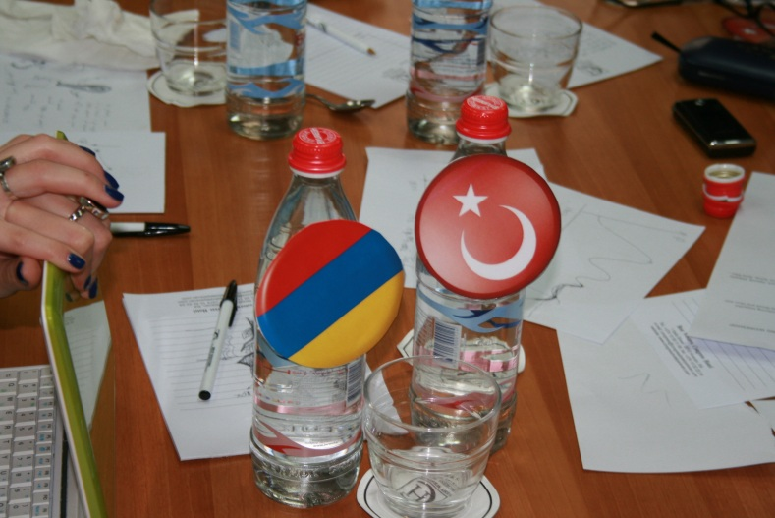
When asked: what are you taking from Armenia back to Turkey….
I had a chance the first time to go into a Christian church and put a candle…
…some things that were very obscure before became clear…
I am now looking at the reason of the conflict between our countries from two perspectives now…
… I want to hear more news about Armenia in our media with positive stories…

Slide 11
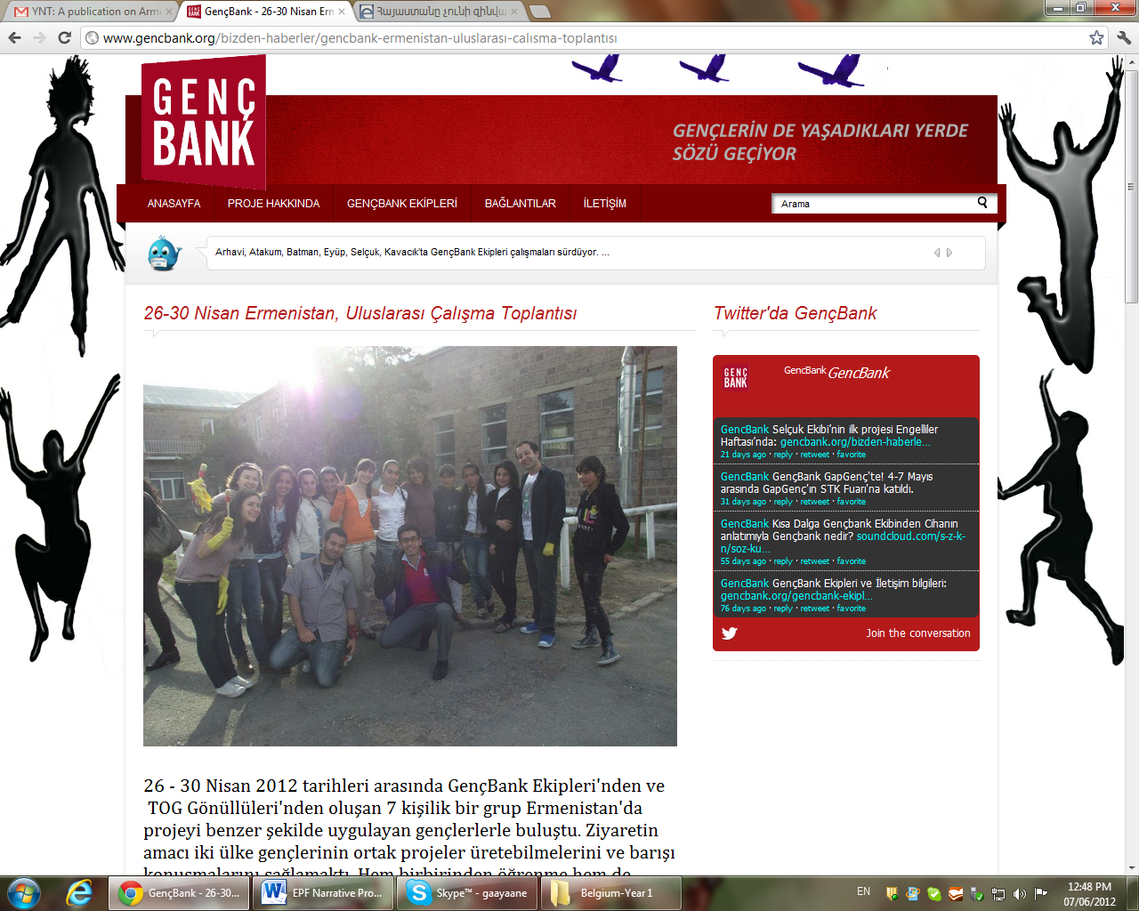
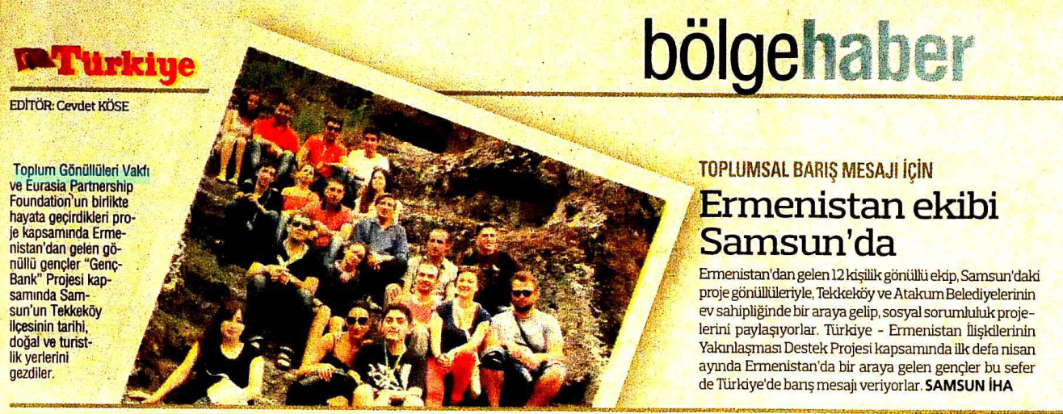
Continued communication: media and friendships
http://www.youtube.com/watch?v=FWQ7CMISXGk&feature=share
http://www.facebook.com/#!/groups/150093068408530/
http://www.youtube.com/watch?v=WzFbFJ_GCzM&feature=relmfu

Slide 12




… leadership at one time meant muscles and power;
but today it means getting along with people.
Gandhi, Mahatma

Slide 13
Cross-Cutting Group Curiosity More interactions More stakeholders Key people/organizations/events Transformation in the society leading to real changes

Slide 14
Recommendations on the way forward | Strengthening and enlarging partnerships | Perspective areas for future joined programs
Cross – cutting between different groups, making it broader (not only rural youth, include universities exchanges, vocational group exchanges) Increase the curiosity in Turkey and Armenia Advocacy in Turkey about the Armenia and the closed border Creating the office for youth (OFAJ experience: invite the professional workers from the offices in Paris and Berlin to share the experience, contact French and German embassies to support this initiative) Increasing the number of the YouthBanks | Strengthen the NGOs and existing network Increase number of people involved in exchanges Key people More mobility European experience | Universities Schools Craftsmen Women Young businessman Artists Social documentaries, scripts, theater Blogs, platforms, websites on impressions, stories, ideas, raising the awareness and increasing curiosity

